Slide 1

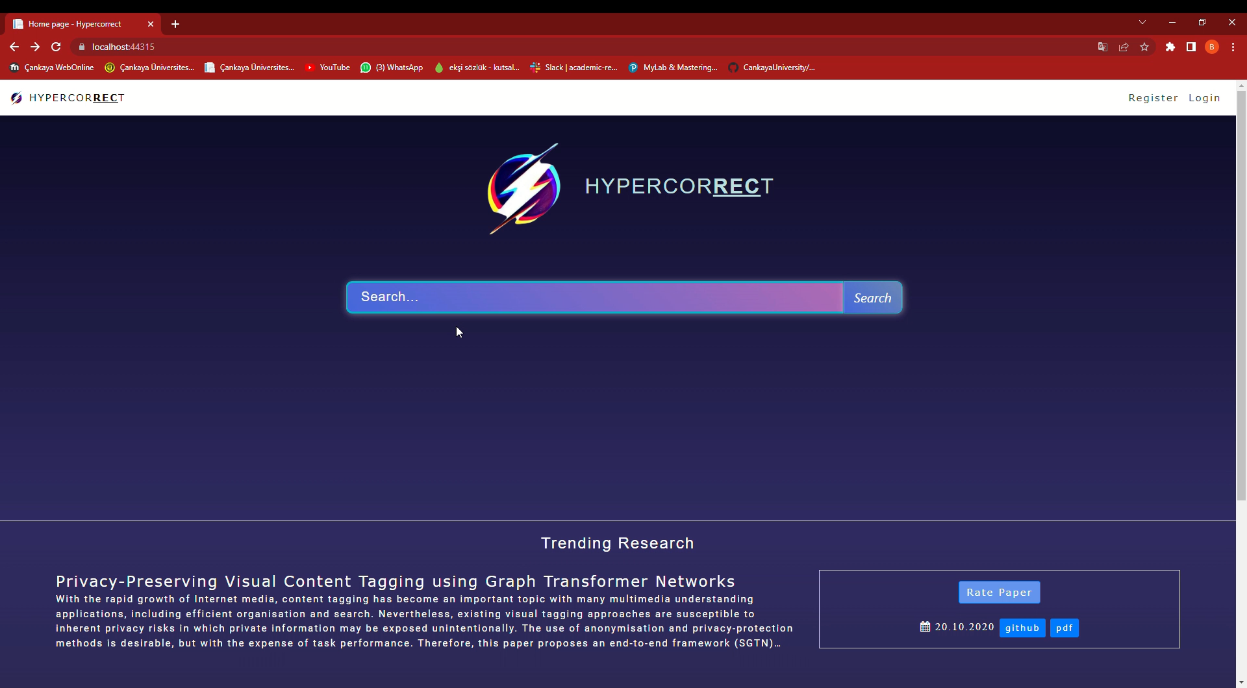

Academic Research Recommender System HYPERCORRECT
Assist. Prof. Dr. Uğur SOPAOĞLU
Anıl Mithatcan AKBAŞ
Başak ÇAVUŞDAĞ
Berkan Taha ÖZDEMİR
Ceren AKKUŞ

Slide 2
Table of contents
01
04
Introduction
Technologies
02
05
Problems
Test Cases
03
06
Solutions
Conclusion

Slide 3
In this project, we developed an academic research recommender system which named as «HYPERCORRECT» The purpose of this Project is to suggest papers that may be of interest to the user, as well as the paper search engine.
INTRODUCTION

Slide 4
PROBLEMS
Waste of Time
Information Pollution
Increase the Number of Papers Published
Finding the article you are looking for can be time consuming.
Due to the widespread use of the Internet.
Unfortunately one of today's problems.

Slide 5
SOLUTIONS
Here are the advantages of HYPERCORRECT:
Hypercorrect allows you to find the article you are looking for in a short time.
Hypercorrect provides some important information about the papers (authors etc.). We will talk about them shortly. Thus, it prevents information pollution.
Due to the widespread use of the internet today, interaction between people has increased in every field. The number of published papers is also increasing day by day.

Slide 6
Technologies

Slide 7










Slide 8
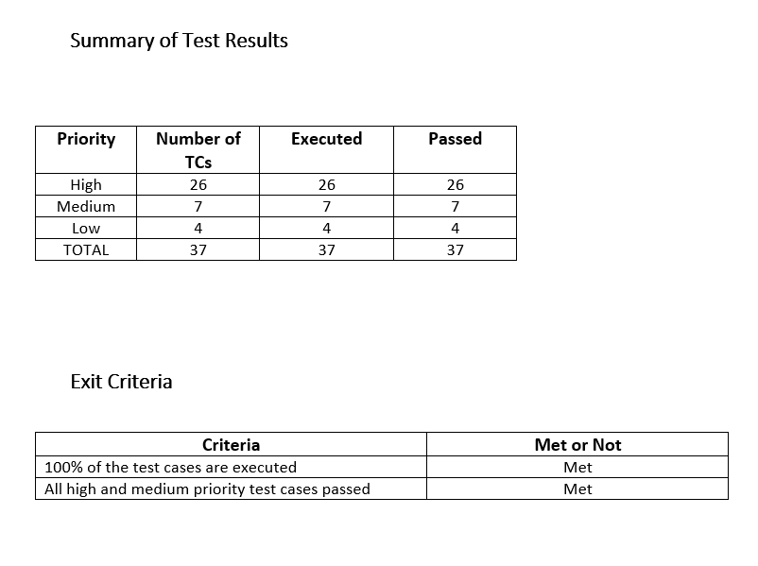
100% PASSED ✔️

Slide 9
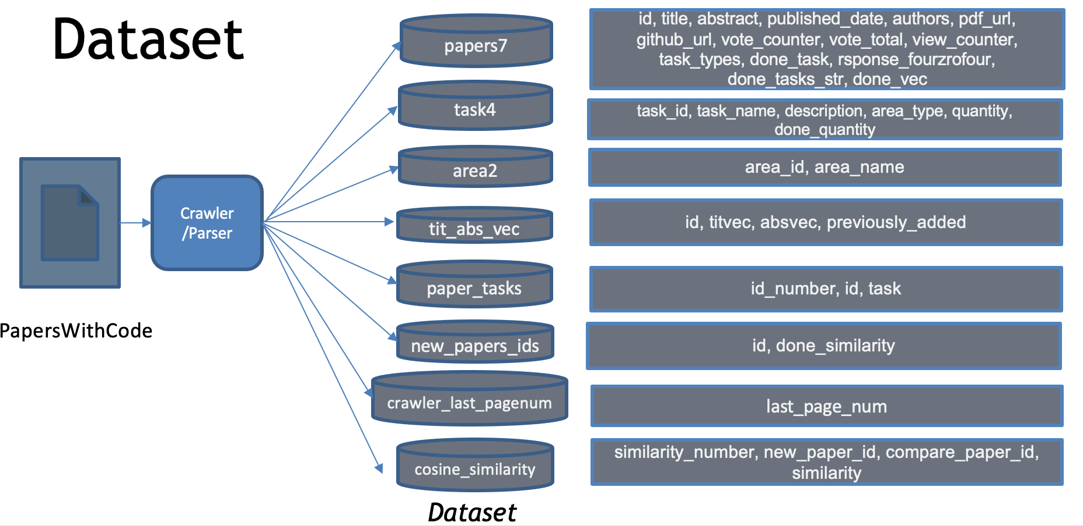

Slide 10
CONCLUSION
Our main goal in this project is to present articles suitable for the user's filters and to suggest articles according to their interests.
We aimed our project to be a solution to the problems we mentioned.

Slide 11
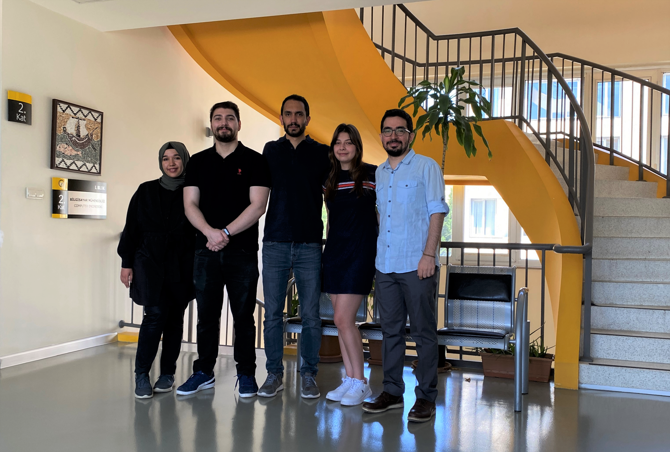


Thanks for Listening

